Slide 1
MOT1421: Economic Foundations Week 6: Keynesian Macro-Economics
Key assumptions of the Keynesian macro model:
No in-built tendency towards full employment; unemployment is the norm
Aggregate demand is the main determinant of the level of economic activity (via the multiplier process)
Autonomous investment demand is the key item of aggregate demand; consumption is a stable proportion of income
Autonomous investment demand is determined by ‘expectations’ of firms (animal spirits)
The future is unknowable; there is fundamental uncertainty; self-fulfilling prophecies
Economic activity exhibits business cycles; (counter-cyclical) fiscal stabilisation policy works
The loanable-funds market does not exist; banks are money-creating institutions; investment is pre-financed by credit; there is no crowding out
Monetary policy is less ‘powerful’ than fiscal policy
Money is a social institution which helps agents to deal with uncertainty (by allowing a postponement of spending)

Slide 2
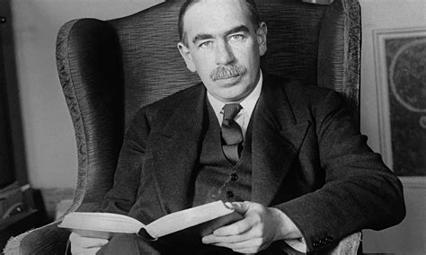
MOT1421: Economic Foundations Week 6: Keynesian Macro-Economics
John Maynard Keynes
(1883-1946) spearheaded
a revolution in economic
thinking, overturning the
neoclassical model.
Keynes argued that aggregate demand
(and autonomous business investment in particular) is the key driver of
economic activity, (un-)employment and the business

Slide 3
MOT1421: Economic Foundations Week 6: Keynesian Macro-Economics
The Keynesian model:
Step 1: an increase in autonomous private investment; pre-financed by new credit from commercial banks; firms have optimistic expectations about future demand and buy extra machines to expand productive capacity; hence, investment demand (= the demand for machines) rises.
Step 2: the multiplier process: output & employment rise in the capital-goods producing industries; income earned in these industries rises; households increase their spending and buy (consumer) goods; production in the consumer-goods producing industries rises; etc.

Slide 4
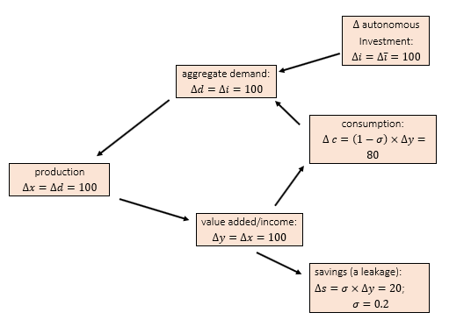
MOT1421: Economic Foundations Week 6: Keynesian Macro-Economics
The Keynesian (demand-determined) circular flow of income:

Slide 5
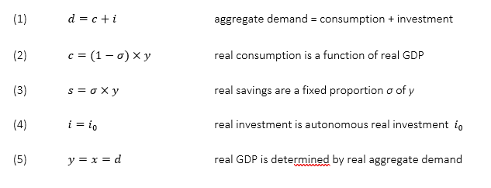
MOT1421: Economic Foundations Week 6: Keynesian Macro-Economics
The Keynesian macro-model:

Slide 6

MOT1421: Economic Foundations Week 6: Keynesian Macro-Economics
The Keynesian multiplier:
or: change in income = the multiplier x change in investments
The multiplier (in this simple model) = 1/sigma
The revolutionary import of Keynes’s macro-economic theory was that there is no self-correcting property or mechanism in the market economy to bring the level of economic activity back to ‘full employment’. Keynes argued that a market economy tends towards an ‘under-employment equilibrium’ – a steady state featuring unemployed workers and unused production capacity.

Slide 7
MOT1421: Economic Foundations Week 6: Keynesian Macro-Economics
Key insights:
There is no market for loanable funds. There is no need for banks to first (ex-ante) mobilize ‘savings’ which can next (ex-post) be used to fund new investment.
business investment is not constrained by the availability of savings, because banks are money-creating institutions which can provide new money (as credit) to finance the investment plans.
a higher propensity to save constitutes a bigger leakage from the circular flow of income; this bigger leakage weakens the multiplier process and will reduce economic growth -> paradox of thrift

Slide 8
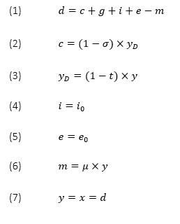

MOT1421: Economic Foundations Week 6: Keynesian Macro-Economics
A more realistic multiplier (derived from a more realistic model):

Slide 9

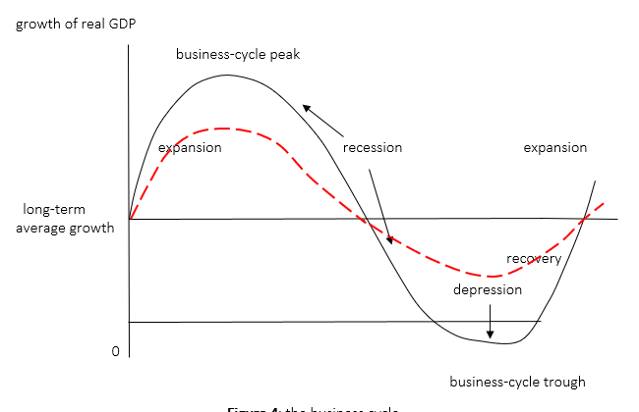
MOT1421: Economic Foundations Week 6: Keynesian Macro-Economics
Fiscal policy in the Keynesian model: the Fiscal Multiplier
Counter-cyclical
fiscal policy;
demand management

Slide 10
MOT1421: Economic Foundations Week 6: Keynesian Macro-Economics
Fiscal stablisation policy (counter-cyclical demand management):
In the down-swing of the business cycle: fiscal deficit
In the up-swing (boom) of the business cycle: fiscal surplus
Over the whole business cycle: a balanced budget
The fiscal multiplier, public debt-to-GDP ratio and fiscal austerity:
suppose govt. investment is reduced -> fiscal surplus -> debt goes down, BUT if fiscal multiplier > 1, then GDP will decline more than public debt -> public debt-to-GDP ratio will go up!

Slide 11
MOT1421: Economic Foundations Week 6: Keynesian Macro-Economics
Monetary policy in the Keynesian model:
Policy instrument of central bank = the interest rate
A higher interest rate will lower private investment -> a negative multiplier effect on demand, output, employment
However, the impact of changes in the interest rate on business investment is relatively small, especially that of a reduction in the interest rate
Monetary policy is by far not as effective in influencing demand, output and employment than fiscal policy

Slide 12
MOT1421: Economic Foundations Week 6: Keynesian Macro-Economics
The liquidity trap:
In a period of slow growt and high uncertainty, households and firms will hold on to their cash (= liquidity) for precautionary reasons.
This means that liquidity preference is high. Incomes are not spent, banks are flushed with (excess) savings.
A reduction in the interest rate will not increase business investment, because firms’ animal spirits are depressed (business confidence is low).
Monetary policy (lowering interest rates) cannot get the economy out of the liquidity trap. Interest rates may be lowered to the ZLB without effect.
Fiscal stimulus (rising public deficits) increase aggregate demand and raise economic growth and can restore business confidence.

